Slide 1
Student Engagement Program
#Bano Idea Wallah
—---------- INSIDE PPT —---------------
Contest
ML & AI
Personal Suggestions to students
Bring Traffic to PW app.
Anuj Verma | Associate || NPI
anuj@pw.live
78886-65915

Slide 2

Objective to Implement this Idea
Bring the student who wants to study only from youtube, to our PW app.
Helps the students to better understand their positions.
Bring more growth to our sales.
Use the Technology & surprise the students about their insights.
Personal Suggestions to students using technology.
Use of ML & AI in our PW app for Suggestions & personal Recommendations.
Bring Traffic to PW app

Slide 3

What is the Idea ?
The basic idea behind the Student engagement program is to build more engagement among students on youtube, and we will redirect the students from youtube to our PW App. and Gave them Personal Suggestions & recommendations.
Q . How can we help students to come and join the PW app and buy any course ?
Ans. Go to PW app, and participate in contest.
we will make the daily or weekly contest for students for JEE, NEET, and Board (11th & 12th), and tell students to participate in this contest, and this contest is always free for all.
All the student who are on youtube (mainly the student who is really focused towards his aim) will definitely join this contest (because of no fees).

Slide 4


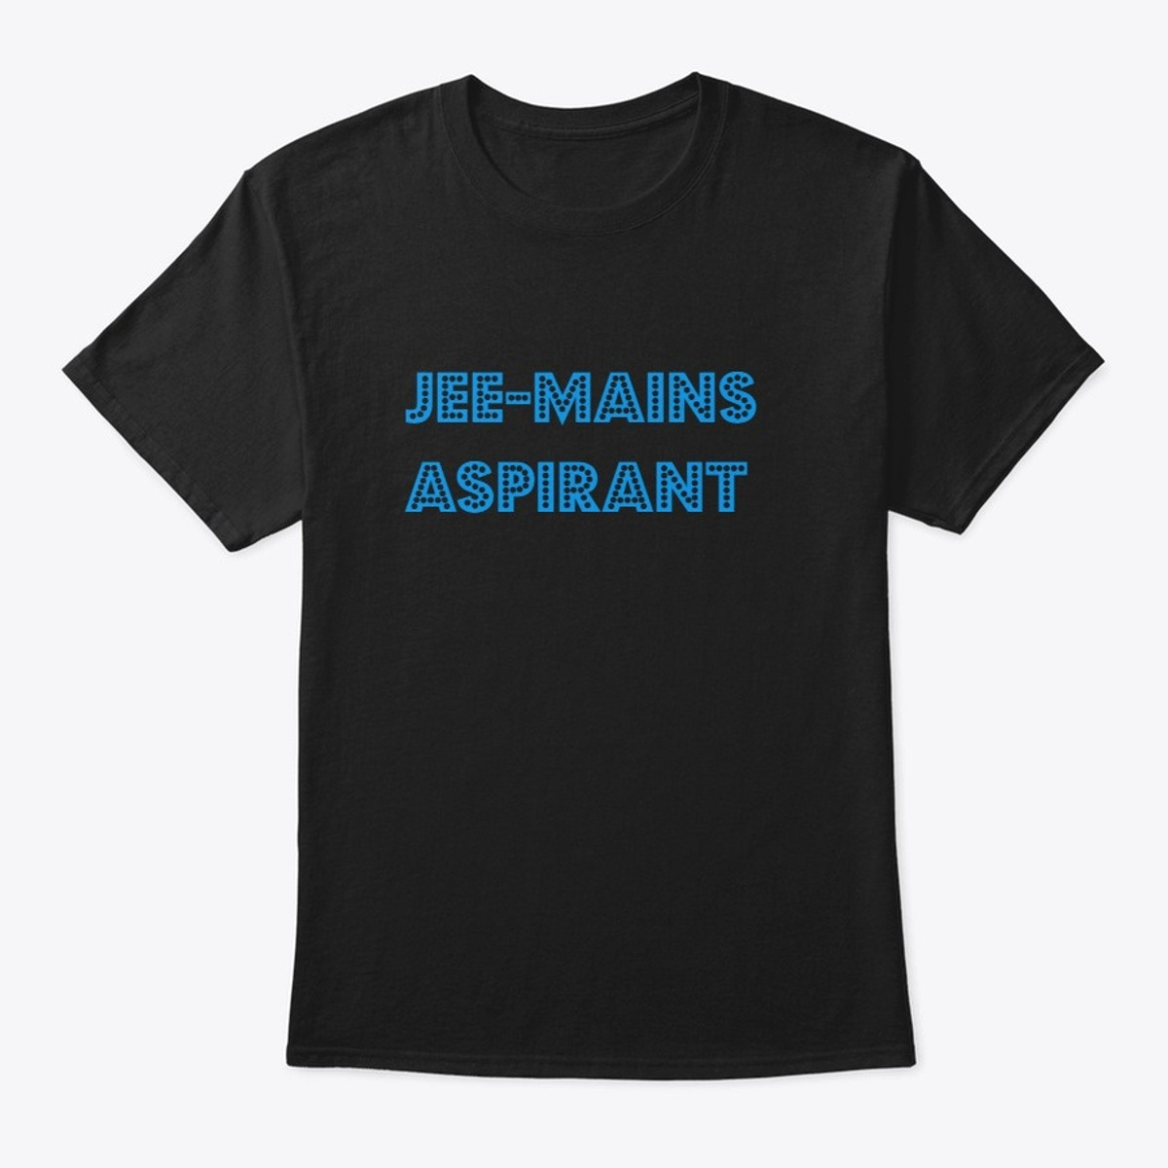

What is the benefit for the student to participate in contest ?
The students will given rewards based on their rank.
The Reward can be in the form of T-Shirts, Bottles, Bags, Hoodies, or PW Coins.
Student will get to know, in which topics he is weak.
With the Result, he will also receive the analysis of his data ( time taken, wrong questions, weak part )
He will receive the daily suggestion about the weak topics on PW app.
After participating in so many contest, he got many PW Coins ( Ex: he participated in 15 contest and get 1500 coins, and the course is of RS.3500/-, so we can give him the course for RS.2,000/- only).
The student can earn coins & buy the course.

Slide 5
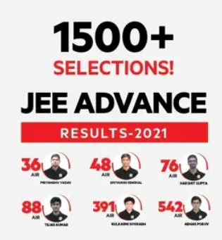
Anuj do you really think Giving 1500 coins as 500 Rs. discount to student will really worth it ?
Yes, it is really worth it.
How ?
We were successful in getting the students from YouTube to the app.
The student who earns the coins, it means he is really focused towards his study and can get a good rank in future, and this means he may increase the ranks of PW.
After Personalized suggestions, the student can buy the course, and this can boom to our sales.
It will bring more traffic to our Pw App & helps our sales team & counsellor to share student’s weak part, and tell him to why to take this course.
The Rank of student will worth our discount.
We will get Best Student.
(Personally I Believe, Jo Student Khud mehnat kr k Course lega, wo Best hi krega)
Abhi tk Jo Bachha Youtube se hi pdhna chahta tha, wo ab suggestions k karan course lene k baare mai sochega

Slide 6
Q . Only Reward can help student to think & buy the course ?
Ans. Definitely, NO.
Q . So, how we will make the student to think about buying the course ?
Ans. here comes the idea to use Technology.
HOW ?
Every student must registered himself in ordered to participate in contest, after the contest we can make the use of Machine Learning & Data Analysis for each student who participated, and by using this we will share the personalized analysis of their judgement to attempt the questions, and tell them in which topic they are weak and on the weak topic we can suggest them the courses or the free resources.(Free resources for Initial times )

Slide 7
How can Machine Learning & Artificial Intelligence Helps us to grow sales ?
Detection of opportunities and potential students.
This allows teams to spot the best sales opportunities as early as possible
Offer a personalized Student experience.
Improve sales team productivity.
Machine learning allows salespeople to save time on manual, forecasting, and reporting tasks. So sales teams can spend more time dealing directly with the customer and ensure good service.
After Detecting the Weakness of Students, Our Counsellors can easily target the students, and tell them how buying the PW course can help the student to grow and get good rank.
A 2019 study found that 84% of B2B marketers expect to see value from their machine learning investments within a year an another one found that 85% of marketers using artificial intelligence believe it will drive double-digit revenue growth within two years. It is becoming clearer every day that every aspect of marketing can and will be improved with machine learning.
Personal Suggestions & Personal Recommendations is the KEY in our case.

Slide 8
Let’s take a Scenario of student name ‘Anuj of class 11th, who don’t want to buy course and want to continue from youtube only.’
On Youtube, We will tell the students on Live classes, that Go & Register on PW app and participate in the Contest of Magnetism for class 11th, Anuj thinks that he is master in Magnetism, so he decided to participate.
Anuj, register for contest & participate in it.
After few days the result out, and the Anuj got 63 out of 100 and Receive 63 pw coins.
Anuj, now thinks that why he got so less marks, and then he see this analysis for the contest, and got to know he is weak in part D of magnetism and see the suggestion to buy this course & some free resource as well.
But, Even he got to know about part D, he don’t buy the course and starting to learn again from youtube & free resources.
And then in 2nd week again the contest held, and Anuj participated in it, and this time he got 77 out of 100, and 77 coins and total he receive till 2nd contest is 77+63=140 coins, and now he again see the suggestions about his previous result about Magnetism.
Now, he started to think that the Magnetism course is of Rs 780/- only & it can have max discount of 50%. If Anuj can get 390 coins, then he can buy the course of Rs 390/- only, so he decided to participate in contest. And after a month he got 390 coins and then he bought the course for 390/-

Slide 9
Thank You!
Anuj Verma | Associate | NPI
anuj@pw.live | 78886-65915
Linked In

